Slide 1

EDA on Facebook Utilization Data
Submitted by:
Natasha Rana
(CDF Program)

Slide 2

Introduction
Facebook was launched in 2004, by Mark Zukerberg.
It is one of the World's largest social media platform.
Facebook thrives on the ideology of "Helping people connect to their family and friends, find communities, and grow businesses across the globe."

Slide 3
Flow of the project
Step 1:
Defining the Problem Statement:
Step 2:
Choosing the right tools(Importing the Libraries):
Step 3:
Collection of Relevant Data(Importing the Dataset):
Problem Statement is focused on the issues faced by the business.
Dataset can be in the form of csv, json, excel, or any other format.
Numpy, Pandas, Matplotlib, Seaborn, Pandas Profiling.
Step 4:
Pre-profiling:
Step 5:
Data Pre-processing:
Step 6:
Post-profiling:
To check for inconsistent data, i.e., missing values, outliers, duplicate values.
To clean data, remove unnecessary data, add relevant data.
To confirm whether data pre-processing has been done correctly or not.
Step 7:
Exploratory Data Analysis(EDA):
Step 8:
Conclusion:
Step 9:
Actionable Insights:
Asking the RIGHT questions and answering them with the help of visual representations.
The gist of the entire analysis.
What can the company do to improve its current situation.

Slide 4
Problem Statement
The objective of the proposed framework is to:
Study and analyze the differences in the way users are using Facebook based on their gender, age-group, etc. and,
Identify a pattern out of it.
This pattern might help the company in the next set of iteration development.
This hidden pattern could end up improving their application and the user experience.

Slide 5
Data Description
No. | Column Name | Description
01 | userid | A numeric value uniquely identifying the user.
02 | age | Age of the user in years.
03 | dob_day | Day part of the user's date of birth.
04 | dob_year | Year part of the user's date of birth.
05 | dob_month | Month part of the user's date of birth.
06 | gender | Gender of the user.
07 | tenure | Number of days since the user has been on FB.
08 | friend_count | Number of friends the user has.
09 | friendships_initiated | Number of friendships initiated by the user.
10 | likes | Total number of posts liked by the user.
11 | likes_received | Total Number of likes received by user's posts.
12 | mobile_likes | Number of posts liked by the user through mobile app.
13 | mobile_likes_received | Number of likes received by user through mobile app.
14 | www_likes | Number of posts liked by the user through web.
15 | www_likes_received | Number of likes received by user through web.

Slide 6
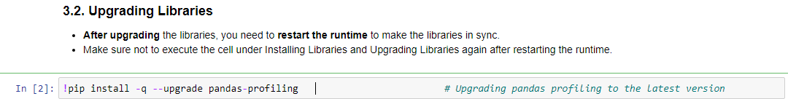
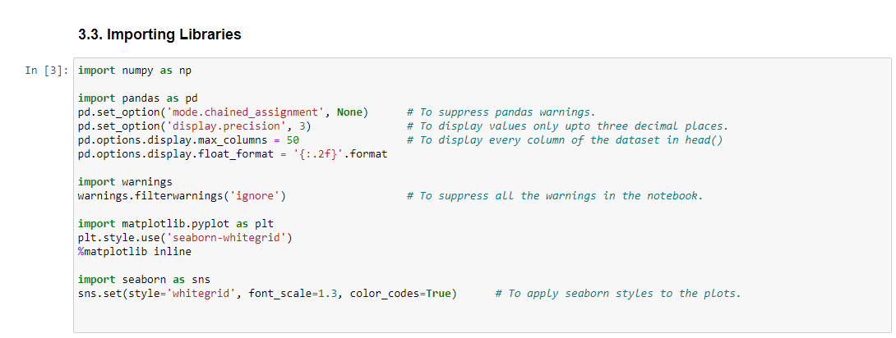
Importing the Libraries

Slide 7
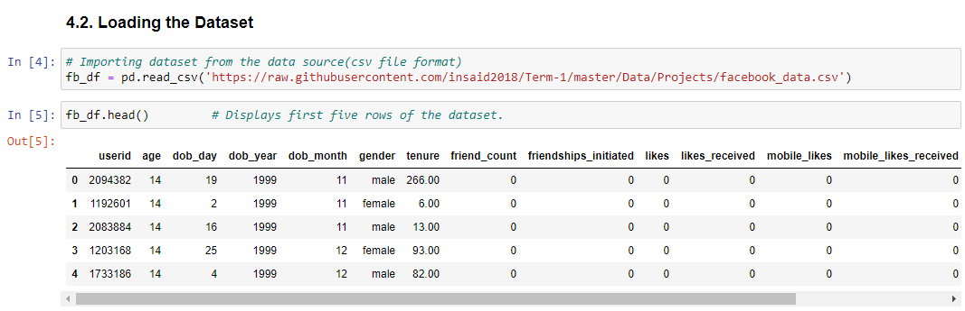
Importing the Dataset

Slide 8
Pre-profiling
Dataset info:
Number of variables: 15
Number of observations: 99003
Duplicate rows: 0
Missing values(177):
Gender = 175
Tenure = 2
Variables types:
Numeric = 14
Categorical = 1
Age column contains outliers.

Slide 9
Data Pre-processing
Imputation of missing values:
Replace the null values of gender column with its mode, as it is a categorical variable.
Replace the null values of tenure column(numerical variable) with its median, because standard deviation is very high for tenure so mean does not represent the data accurately.

Slide 10
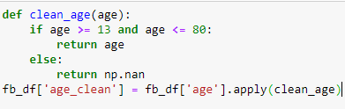
Data Pre-processing(cont.)
Treatment of outliers in the age column:
Created a function clean_age. Then created a new column age_clean(to check for all the possibilities) and applied clean_age function to it :
Here, we have set the maximum age limit to 80 because if we set the maximum age limit to 90, the outliers were still not completely removed.
We have deliberately introduced NaN/null values so that we can later on replace these values with the median of age column.
Later on, applied clean_age function to the age column. Replaced NaN/null values of age column with its median.
Dropped five columns: 'userid ','dob_day','dob_month ', 'dob_year ', 'age_clean’.

Slide 11
Post-profiling
Dataset info:
Number of variables: 11
Number of observations: 99003
Missing cells: 0
Duplicate rows: 93(0.1%)
Variables types:
Numeric = 10
Categorical = 1
Dropping Duplicate rows

Slide 12
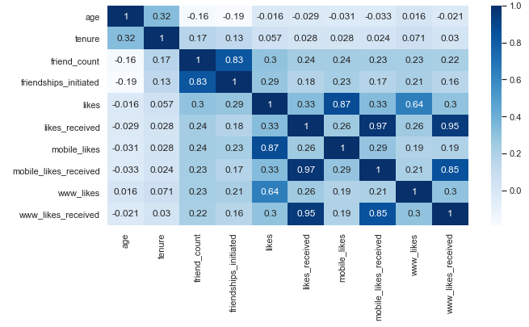
Heat map/Correlation Matrix

Slide 13
Exploratory Data Analysis(EDA)
EDA consists of analysis based on four criterion:
Gender of the users
Age-group of the users
Least active users on Facebook
User accessibility(Mobile Devices vs. Web Devices)

Slide 14
Analysis based on the gender of the users

Slide 15
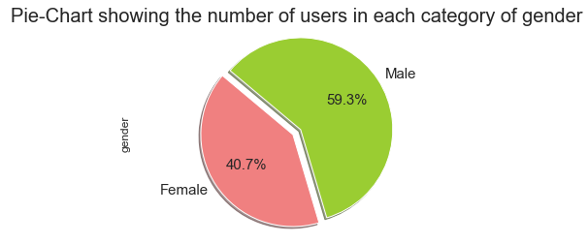
What is composition of male and female users?
Male users dominate Facebook.

Slide 16
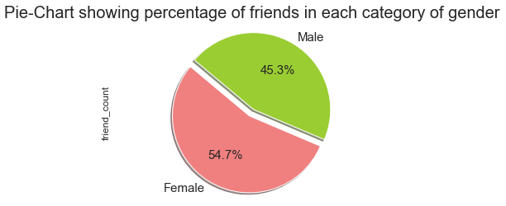
Which category of gender has more friends?
Women tend to have around 9% more friends than men do, which is an indication of their willingness and ability to connect with multiple people and communicate with others.

Slide 17
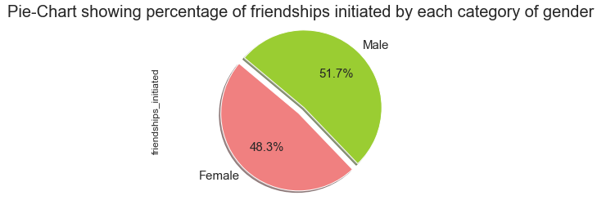
Which category of gender initiates more friendships?
Male users have initiated around 3% more friendships as compared to female users.

Slide 18
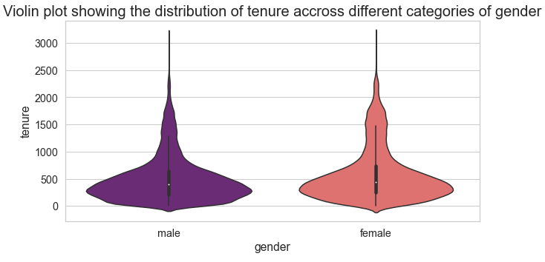
What is the distribution of tenure across different categories of gender?
The number of days male and female users have been on Facebook is majorly concentrated between 0-800 days.
Very few male users have tenure above 2000 days, in comparison to female users.
This means that some male users might have a tendency to leave/abandon Facebook after a duration of 2000 days.

Slide 19
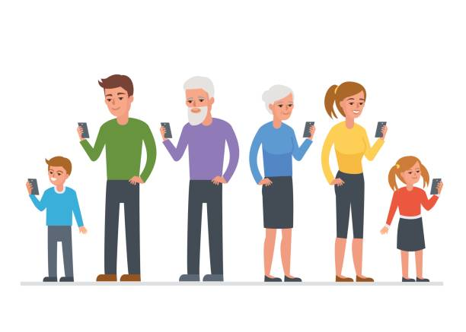
Analysis based on age-group of the users

Slide 20
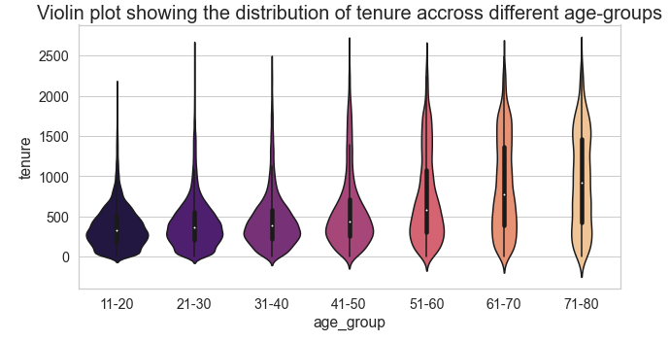
What is the distribution of tenure across different age-groups?
An important observation in the age-groups 11-20 and 21-30, is that there are very few users having tenure above 2000 days.
This means these users might be tempted to abandon Facebook after certain period of time due to other trending social media platforms.

Slide 21
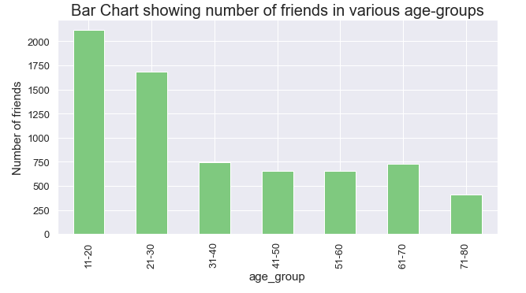
Which age-group has more friends?
Age-groups 11-20(teens) and 21-30(youth)have more friends.
Whereas, age-group 71-80(elderly) has the least number of friends .

Slide 22
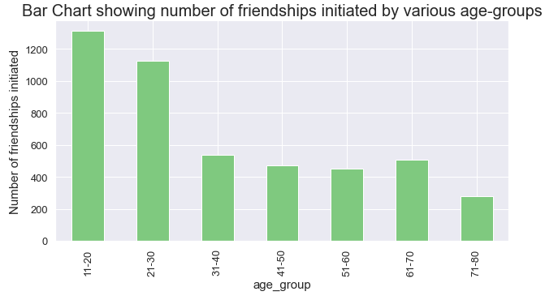
Which age-group initiates more friendships?
The age-groups 11-20 and 21-30 tend to initiate more friendships.
Whereas, the age-group 71-80 has initiated least number of friendships as compared to the other age-groups.

Slide 23
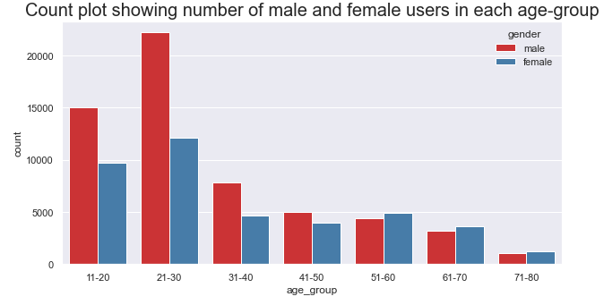
How many male and female users are there in each age-group?
The highest number of male and female users belong to the age-group 21-30.
The least number of male and female users belong to the age-group 71-80.

Slide 24
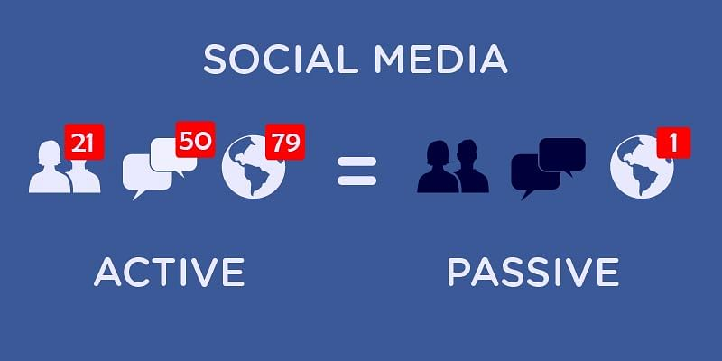
Analysis based on the least active users on Facebook

Slide 25
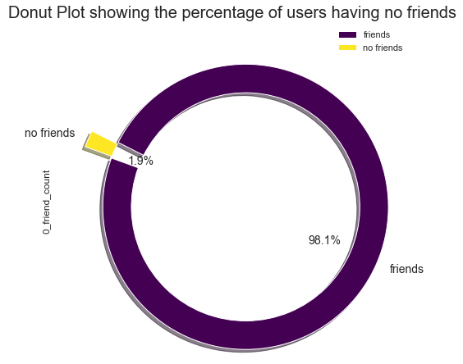
How many users have no friends?
These users have just joined Facebook or these could be accounts of famous personalities whom people usually follow.
Another reason could be that these users might have set their settings to private mode, so there friends are not shown to the public.

Slide 26
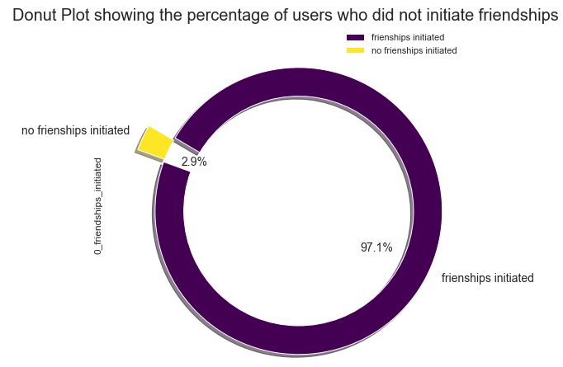
How many users did not initiate friendships?
These users have just joined Facebook or,
These users are too shy to approach people on Facebook.

Slide 27
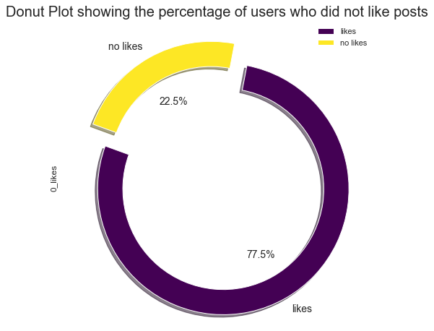
How many users did not like any posts?
These users have zero activity level(i.e., no posts liked).
This indicates that these users did not find posts interesting enough or probably they are just scrolling down the news feed for time pass.

Slide 28
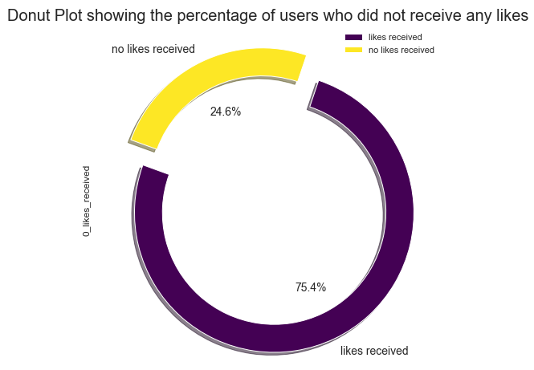
How many users did not receive any likes?
The posts of such users are viewed by limited audience, due private settings.
The posts of such users might be offensive, obscene, or just not interesting enough.
These users have just joined Facebook and not posted any content yet.

Slide 29

Analysis based on the user accessibility(Mobile Devices vs. Web Devices)

Slide 30
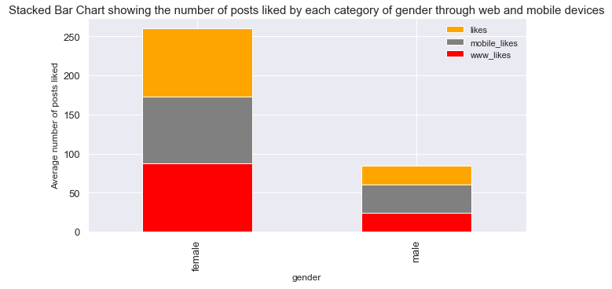
What is the average number of posts liked by users (based on gender)through web vs. mobile devices?
Both(male and female users) prefer mobile devices to access Facebook.

Slide 31
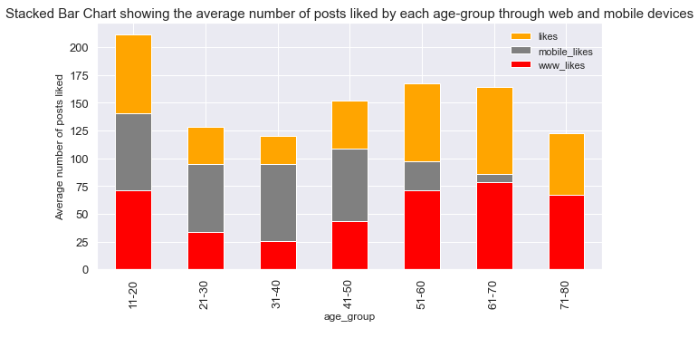
What is the average number of posts liked by users (based on age-group)through web vs. mobile devices?
Mobile devices are a favored option to access Facebook as compared to web devices across all age-groups, except for the age-group 71-80.
For the age-group 71-80, average no. of posts liked through mobile devices is lower than the average no. of posts liked through web.

Slide 32
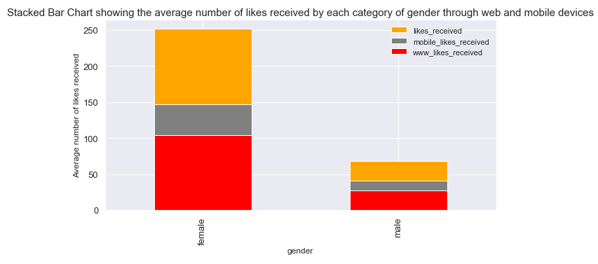
What is the average number of likes received by users(based on gender) through web vs. mobile devices?
Both(male and female users) prefer mobile devices to access Facebook.

Slide 33
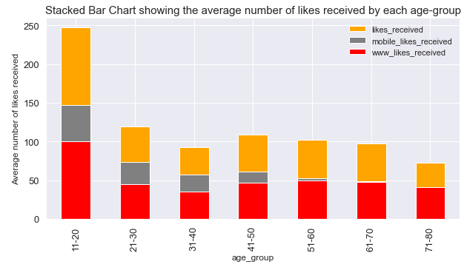
What is the average number of likes received by users(based on age-group) through web vs. mobile devices?
Overall, mobile devices are a favored option to access Facebook as compared to web devices across all age-groups, except for the age-groups 61-70 and 71-80.

Slide 34
Conclusion
The number of male users are more than that of female users.
Female users have more friends on Facebook as compared to male users. However, men tend to initiate friendships more than women.
Most active users of Facebook belong to the age-groups 11-20 and 21-30, i.e., teen and youth population.
Least active users of Facebook belong to the age-group 71-80, i.e., elderly population.
The users from age-groups 11-20 and 21-30, might be tempted to abandon Facebook after certain period of time due to other trending social media platforms.
Overall, users prefer mobile devices to access Facebook as compared to web devices, except for the users belonging to the age-groups 61-70 and 71-80.

Slide 35
Actionable Insights
The company can create its products/services majorly catering to the needs of the below- mentioned segments as they are most active users of Facebook. Facebook can target its marketing efforts towards their target market consisting of:
Women.
Users from age-groups 11-20 and 21-30.
The least active members on Facebook could most likely switch to other social media platforms due to lack of interest or lack of awareness. An appropriate marketing strategy is required to retain such users. Hence, the company should focus on the following pain points:
Men who do not like any posts.
Users from age-groups 71-80.
Since, mobile devices are being majorly preferred by users to access Facebook. The company shall focus on constantly improving their mobile app to enhance users' experience to the fullest.
An Awareness Campaign for the Facebook mobile app is required to promote it amongst the elderly population(61-70 and 71-80 age-groups).
Facebook needs to constantly adapt to the changing trends of social media platforms in order to retain users, specifically, users belonging to the age-groups 11-20 and 21-30.

